Slide 1
Group 5
Diego I, Saiqa, Kat

Slide 2
Own Model

Slide 3
Chosen Dataset: CIFAR-10
Considerations:
Size of the dataset (CIFAR-10 has more images to train with than alternative)
Type of images:
CIFAR-10: 32 x 32 of different categories
Other dataset: medium sized images, mainly from Google
Probability of good outcomes:
CIFAR-10: very different categories (animals vs. vehicles)
Other dataset: animals only
Ease of implementation:
Some pre-written code and experience with CIFAR-10
Possible resizing of images from other dataset needed

Slide 4
Overview of the problem
Create deep learning model
Train on chosen dataset (CIFAR-10)
Goal: Classification of images into classes:
Airplane
Automobile
Bird
Cat
Deer
Dog
Frog
Horse
Ship
Truck

Slide 5
Data processing
CIFAR-10 contains 6000 images per class:
No missing data
No data imbalance
Processing steps:
Image
processing
Grayscaling
Normalisation
Image
augmentation
CIFAR-10 Dataset
Random flip
Random rotate
Labels processing
One-hot encoding

Slide 6
Designed CNN Architecture
Model architecture:
Input
images
Augmentation layer
5 Convolutional blocks
Flattening
layer
2 Fully connected blocks
Output
layer
Details:
Flip, rotate
2 x Convolutional:
3 x 3, 64 filters
Batch normalisation
2 x Convolutional:
3 x 3, 64 filters
Average pooling (light), Max. pooling (dark)
Last block: batch normalisation instead of pooling
2x Dense:
64 neurons
Relu
2 x Dense:
64 neurons
Relu
Softmax

Slide 7
Optimisation techniques
Dropout rate: 0.2 (abandoned in final model design)
Epochs: 50
Batch size: 64
Early stopping: patience 10
Optimizer: Adam with learning rate 0.001
Loss function: categorical crossentropy
Alternating between AveragePooling and MaxPooling
Include Batch Normalisation layers

Slide 8
Pre-Trained Model

Slide 9
Transfer learning (1 of 2)
Choice of model - DenseNet 121:
Newer and larger than VGG16 (2018)
Version 121:
Smallest of DenseNet models
Only 121 layers -> still viable to run with our laptops
Connected layers:
Feature maps layers input into all next layers
Aims to solve vanishing gradient problem
Trained on CIFAR-10, CIFAR-100 and ImageNet
Accuracy on CIFAR-10 of c.a. 95%

Slide 10
Transfer learning (2 of 2)
Modifications:
Kept images in RGB
Froze all but last 2 layers
Added two dense layers with 64 neurons each
Added output layer with softmax
Data augmentation and aggressive data augmentation
Optimizer Adam with learning rate of 0.001
Epochs: 50

Slide 11
Evaluation

Slide 12
Own model (1 of 2)
Struggling to improve performance, even with drastically deeper model
Plateau at between 50-78% training accuracy at epochs 25-40
Underfitting: large disparity between training accuracy and valuation accuracy (validation accuracy up to 50% lower than training accuracy
Final training accuracy of 74% at epoch 28, validation accuracy of 32%

Slide 13
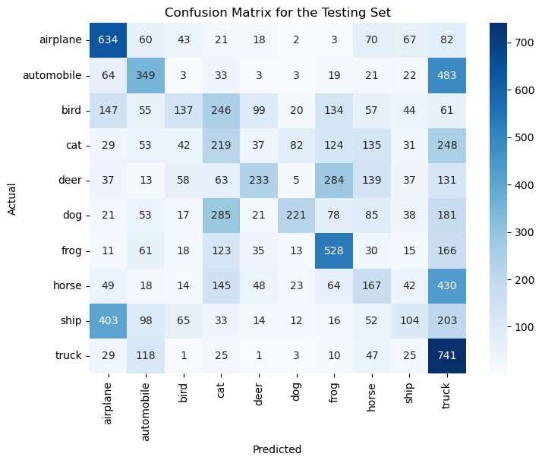
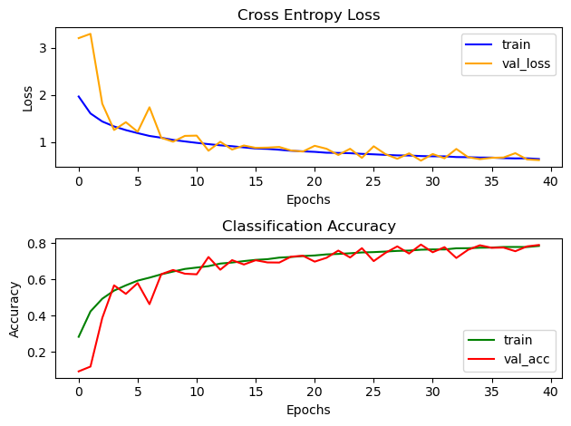
Own model (2 of 2)
Training performance:
Confusion matrix testing:

Slide 14
Pre-trained model (1 of 2)
Achieved medium performance of just under 70% training accuracy after 43 epochs
Failed to achieve good results, even after adjusting metrics
Validation accuracy of 67% shows no drastic underfitting as with own model

Slide 15
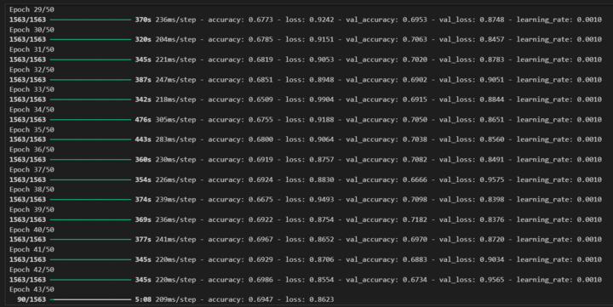
Pre-trained model (2 of 2)

Slide 16
Recap

Slide 17
Overview
Using DenseNet was challenging for the image classification
Results were up- and down without clear improvements
Similar situation with own model
Transfer learning seemed to have yielded more stable results
Could explore further enhancements in future
We learnt that experimentation is crucial and often the best way to determine the optimal model

